Slide 1
DIGITAL INNOVATION COMPETITION PITCH
My Super Buddy Kidspedia
A Fun, Safe and Multi-language AI Learning Buddy for Primary School Students
SCHOOL
SJK(C) Bukit Serdang
TEAM NAME
STUDENT TEAM
Lim Zen Ee, Tee Shao An,
Tan Kai Vern, Lucien Lee
GUIDING TEACHERS
Teacher HO

Slide 2
SLIDE 2: PROBLEM STATEMENT
Three Big Problems Primary Students Face When Learning Alone
1. Adult AI is Too Hard
Tools like ChatGPT are made for adults.
They use big, difficult words and long scientific paragraphs.
Kids aged 7 to 12 feel confused and give up quickly.
2. Multi-Language Trouble
In Malaysian SJKC schools, we learn Chinese, English, and Malay.
Most websites only support one language and cannot read out loud with proper pronunciation.
3. Kids Safety & Bullying
The Internet has unsafe content.
Also, when kids face school bullying or feel sad, they are often afraid to speak up and do not know where to get real help.

Slide 3
SLIDE 3: WHY IT MATTERS
Why Solving This Problem is Urgent and Important for Kids
Protect Kids' Curiosity
Curiosity is our superpower!
When young kids get answers they cannot understand, their desire to discover science and nature fades away.
Simple and fun answers keep curiosity alive!
Stop Bullying & Stay Safe
Every child deserves to feel safe.
Giving kids direct and quiet access to the Ministry of Education (MOE) anti-bullying hotline can save a student's life and mental health.
Fair Learning for Everyone
Not every student has parents at home who speak English or Malay fluently.
A friendly AI buddy bridges the learning gap and makes education equal for all children.

Slide 4
SLIDE 4: DESCRIPTION OF SOLUTION
My Super Buddy: A Smart Learning Station for Primary Schools
What is My Super Buddy?
It is a kid-friendly Web App & Kiosk designed for school libraries, classrooms, and tablets.
It answers any curious student question with:
• Simple words suited for your exact age
• 4 languages (English, Chinese, Malay, Tamil)
• Clear science diagrams & pictures
• Fun educational games
• Direct official anti-bullying helpline
4 Super Powers of Our Buddy
1. Grade-Level Switch:
Year 1-2 gets short funny stories; Year 5-6 gets cool bullet points and science facts.
2. Voice & Read-Aloud:
Speak using the microphone and listen with real human-like voices.
3. AI Picture Studio:
Shows real Wikipedia photos or 3D science diagrams so kids understand easily.
4. Wordwall Games:
Automatically finds matching quiz and puzzle games for every question!

Slide 5
SLIDE 5: HOW IT WORKS
4 Easy Steps: From 'I Wonder Why' to 'Now I Get It!'
Step 1: Ask Question
Type in your question or click the microphone to speak. Choose your grade and language.
Step 2: Safety Check
The system applies Malaysian KSSR syllabus rules, adds a warm compliment, and removes unsafe content.
Step 3: Listen & Look
Read the easy answer, listen with clear voice audio, and see real photos or 3D science diagrams.
Step 4: Play & Laugh
Click to play a matching Wordwall game! Plus, Chippy the cookie pilot flies in with a funny joke!

Slide 6
SLIDE 6: DIGITAL TOOLS & UN SDGS
Modern Technology Connected to United Nations Global Goals
Digital Tools & Technologies Used
• OpenAI API (GPT-4o-mini):
Smart answers adapted for children.
• Microsoft Azure Neural TTS & Web Speech:
Crystal clear voice readout in 4 languages.
• PHP 8.3 & Laragon & MySQL:
Fast, lightweight local web server & question log.
• Wikipedia Action API & Pollinations AI:
Real encyclopedia photos and 3D concept art.
• Wordwall Community Games:
Instant interactive quizzes and puzzles.
United Nations Sustainable Development Goals
GOAL 4: Quality Education
Provides free, fun, and personalized learning for primary students regardless of background.
GOAL 10: Reduced Inequalities
Supports 4 languages so students who struggle with English or Malay can still understand science.
GOAL 3: Good Health and Well-being
Includes direct MOE anti-bullying hotlines to protect students' mental health and school safety.

Slide 7
SLIDE 7: EXPECTED IMPACT
How My Super Buddy Helps Students, Teachers and Our School
For Students
• Builds confidence to ask questions without fear of being judged.
• Turns passive textbook memorization into active, fun discovery.
• Helps students who learn better by listening or looking at pictures.
For Teachers
• Acts as a 24/7 friendly teaching assistant in the library.
• Answers repetitive basic questions so teachers can focus on deeper learning.
• Helps identify what topics students are most curious about.
For School Community
• Transforms school corridors into vibrant digital learning zones.
• Provides a quiet and safe anti-bullying hotline (03-88849325) for any student in need.
• Prepares primary kids for the future AI world safely.

Slide 8
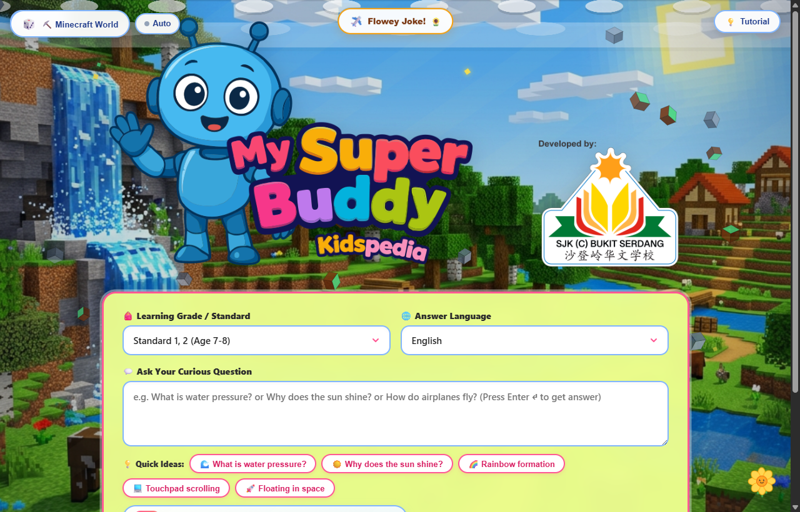
SLIDE 8: PROTOTYPE & LIVE DEMO
Working High-Fidelity Prototype (Clickable & Fully Tested)
Live Working System Features
Local Demo URL: http://localhost/mysuperbuddy/
Tested Highlights:
• Fast Voice & Text Input with quick question chips
• Instant re-asking in English, Malay or Chinese
• Wikipedia encyclopedia photos + 3D concept diagrams
• Matching Wordwall community quiz games
• 16 interactive themes (Minecraft, Space, Roblox)
• Flying Cookie Mascot (Chippy) telling funny jokes
• MOE Anti-Bullying Helpline automatically triggered

Slide 9
SLIDE 9: WHAT WE LEARNED / WHY WE STAND OUT
Why Our Project is Unique and Shines Above Others
Made by Students for Students
We did not build what adults think kids like.
We know firsthand what makes our classmates laugh, what games they play (Minecraft, Roblox), and what makes learning fun!
Complete Learning Loop
Other projects only give text.
My Super Buddy delivers words, crystal-clear speech, science pictures, AND games in one smooth experience!
Real Tech & Serious Safety
We combined modern AI APIs, fast PHP backend, and official MOE anti-bullying hotlines.
It is reliable, runs offline in school intranets, and protects student well-being.

Slide 10
CLOSING STATEMENT & PITCH SUMMARY
Every Curious Kid Deserves a Super Buddy!
Why My Super Buddy Should Advance to the Next Round:
1. Fully Working Prototype: Ready to deploy in school libraries today!
2. Real Student Impact: Inspires love for science, languages and safe exploration.
3. Heart & Safety: Protects students from bullying and online risks.
Thank you very much, respected judges! We are ready for your questions!
SJK(C) Bukit Serdang · Thank You! Q&A Session

